Slide 1
React 강의자료

Slide 2
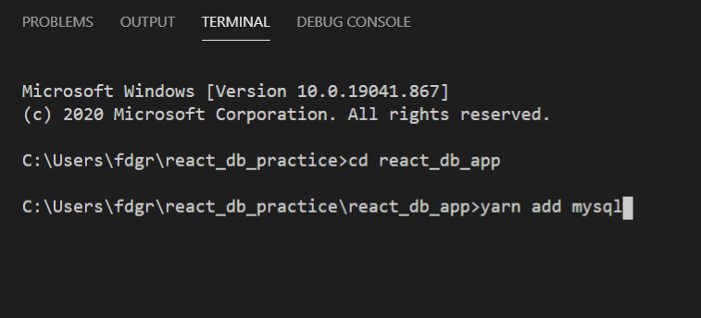

Slide 3
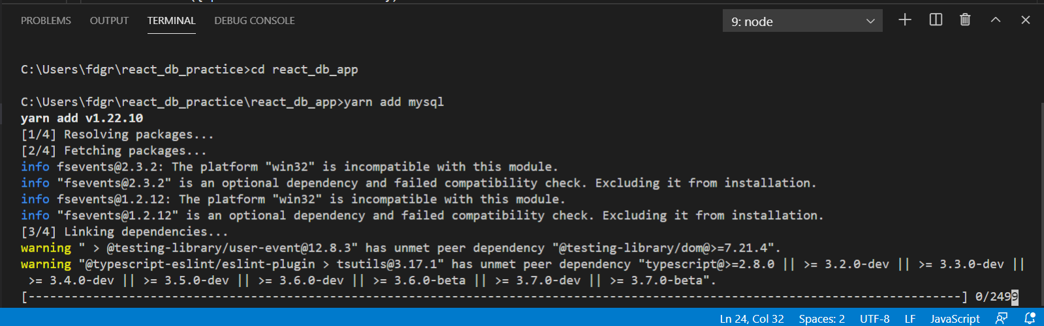

Slide 4
끝

